Slide 1


JAVA INTERNSHIP
PROJECT PRESENTATION
TEAM 3 :
AYUSH PANDEY
RAHUL MAURYA
HAJEERA THABASUM A
MONISH KUMAAR M
SUPRAJA

Slide 2

OUTPATIENT DOCTOR APPOINTMENT SYSTEM
A Web Application Project

Slide 3
Table of contents
01
04
02
05
03
06
Objectives
Tech Stack
Introduction
UML Diagrams
Outcomes
Output

Slide 4

1
OBJECTIVE

Slide 5
OBJECTIVES
Enhance User Experience
Simplify the process of booking outpatient appointments for patients.
Provide an intuitive interface for doctors to manage schedules efficiently
Optimize Healthcare Operations
Reduce waiting times through effective appointment management.
Enable seamless communication between patients and healthcare providers.

Slide 6
2
INTRODUCTION

Slide 7
Introduction
Problem Statement
Traditional appointment booking systems are often inefficient, time-consuming, and lack convenience for both patients and healthcare providers.
Solution
The proposed web application bridges this gap by providing an intuitive platform for patients to book appointments seamlessly while enabling doctors to manage their schedules effectively.

Slide 8
3
OUTCOMES

Slide 9

Outcomes
Enhanced efficiency in booking outpatient appointments, reducing manual processes and waiting times.
Improved user experience through a streamlined and intuitive interface for patients and doctors.
Effective management of doctors' schedules, enabling better resource allocation.
Strengthened communication between patients and healthcare providers through real-time updates and notifications.

Slide 10
4
TECH STACK

Slide 11


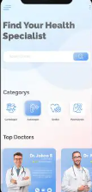

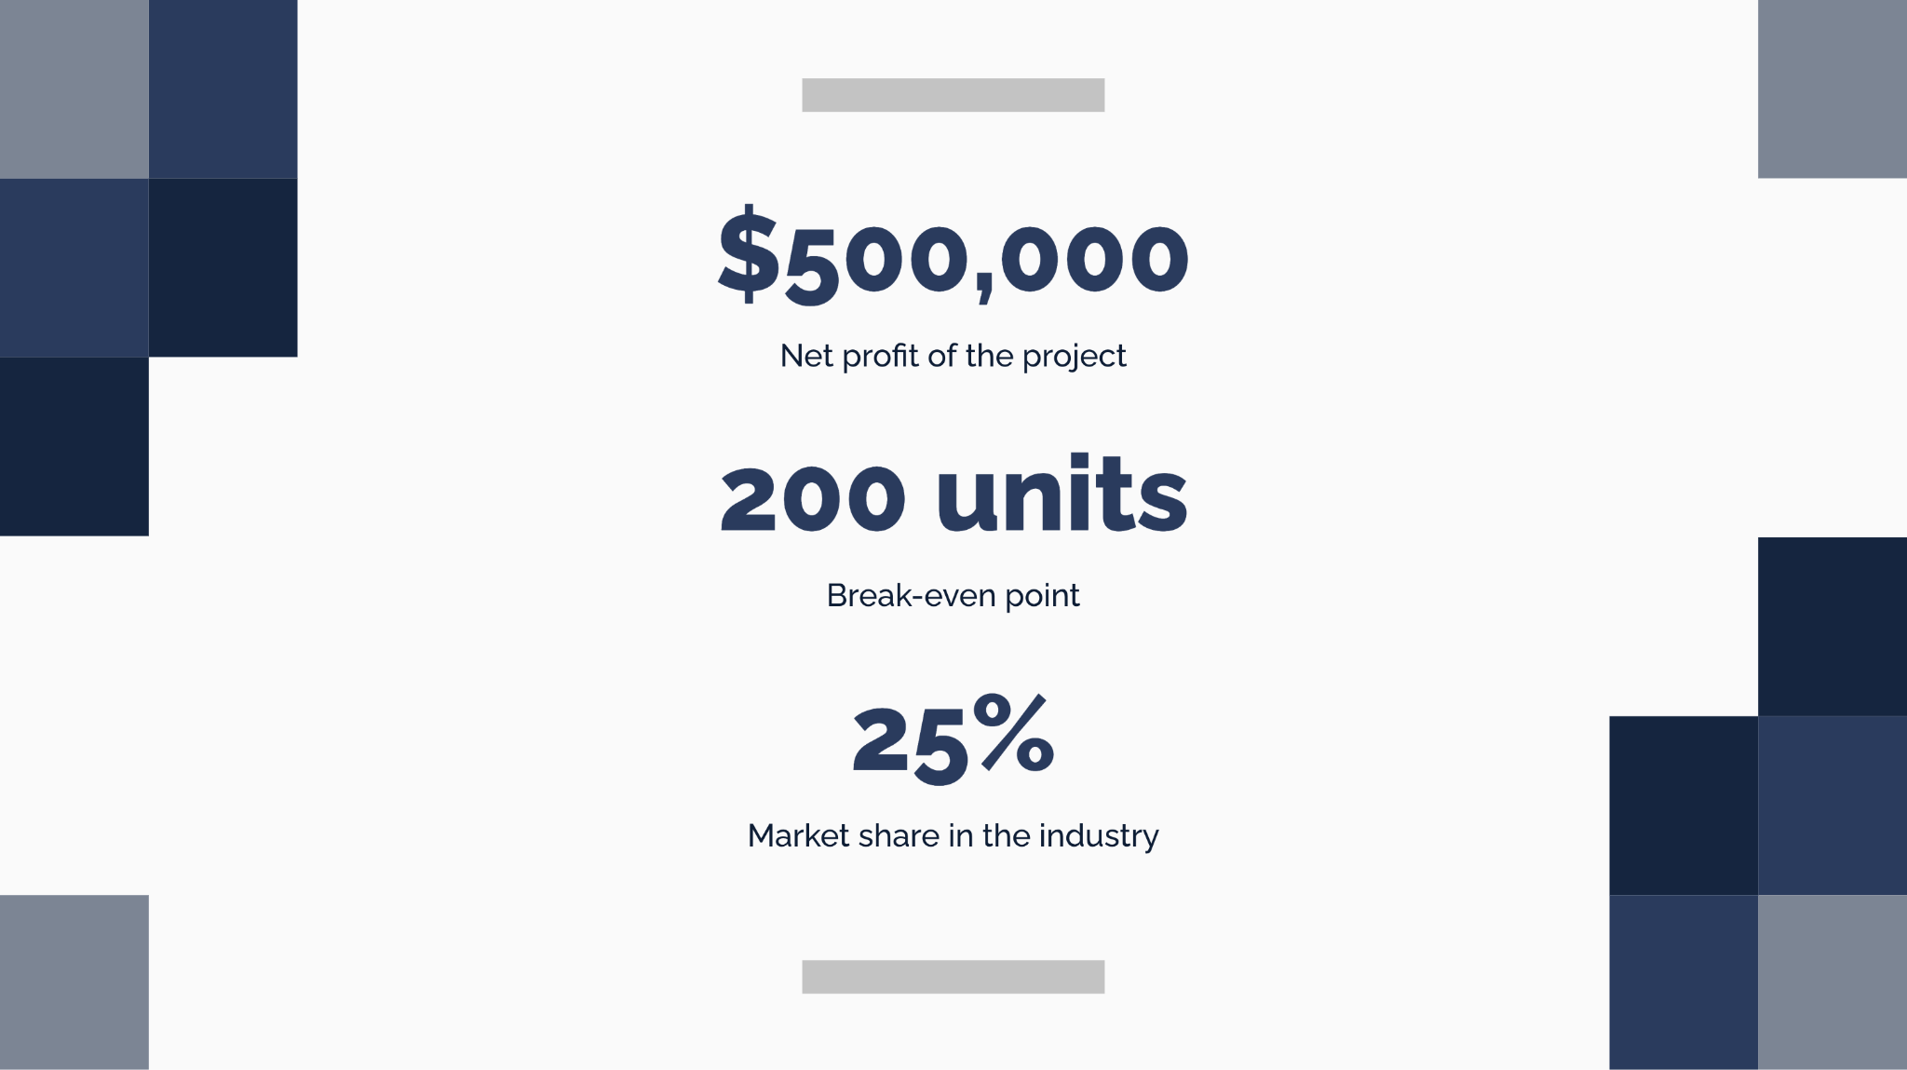

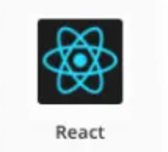




Slide 12
5
UML DIAGRAMS

Slide 13
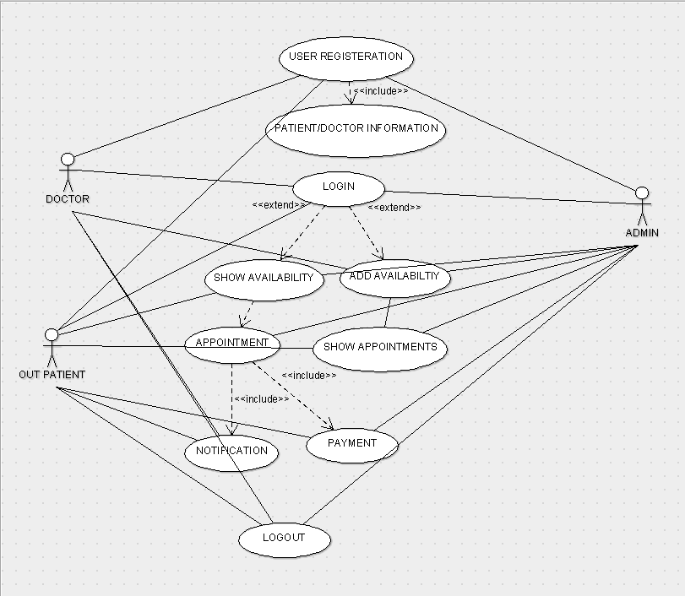
USE-CASE DIAGRAM

Slide 14
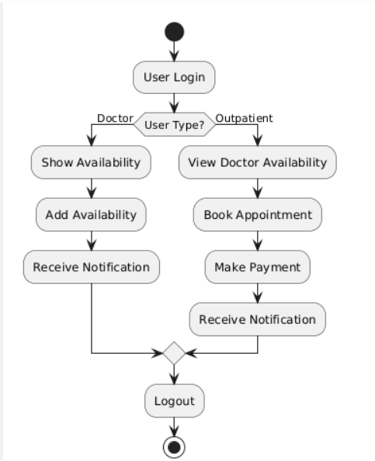
ACTIVITY DIAGRAM

Slide 15
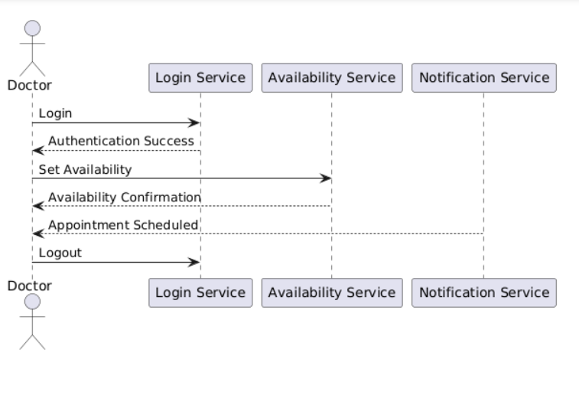
SEQUENCE DIAGRAM

Slide 16
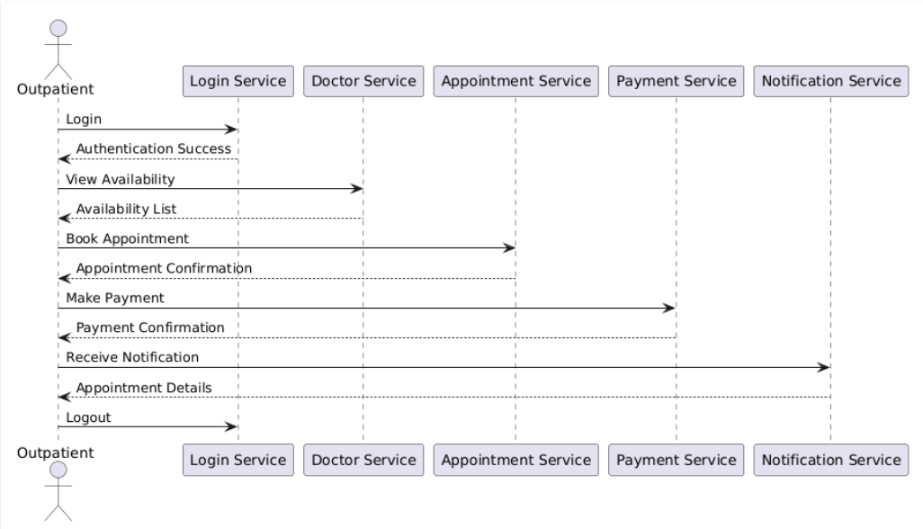
SEQUENCE DIAGRAM

Slide 17
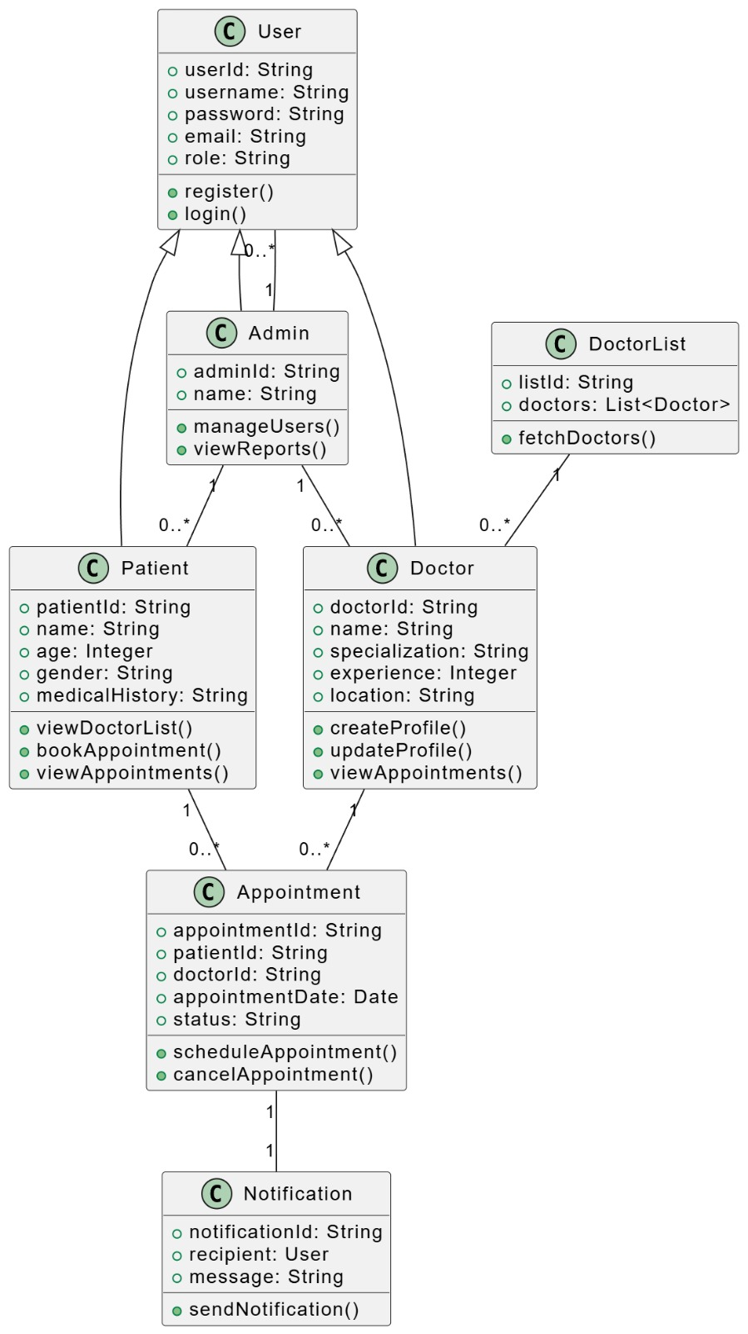
CLASS DIAGRAM

Slide 18
6
Output

Slide 19

HOME PAGE
Click here to Register
Click here to Book an Appointment
Click here to Login as Admin

Slide 20
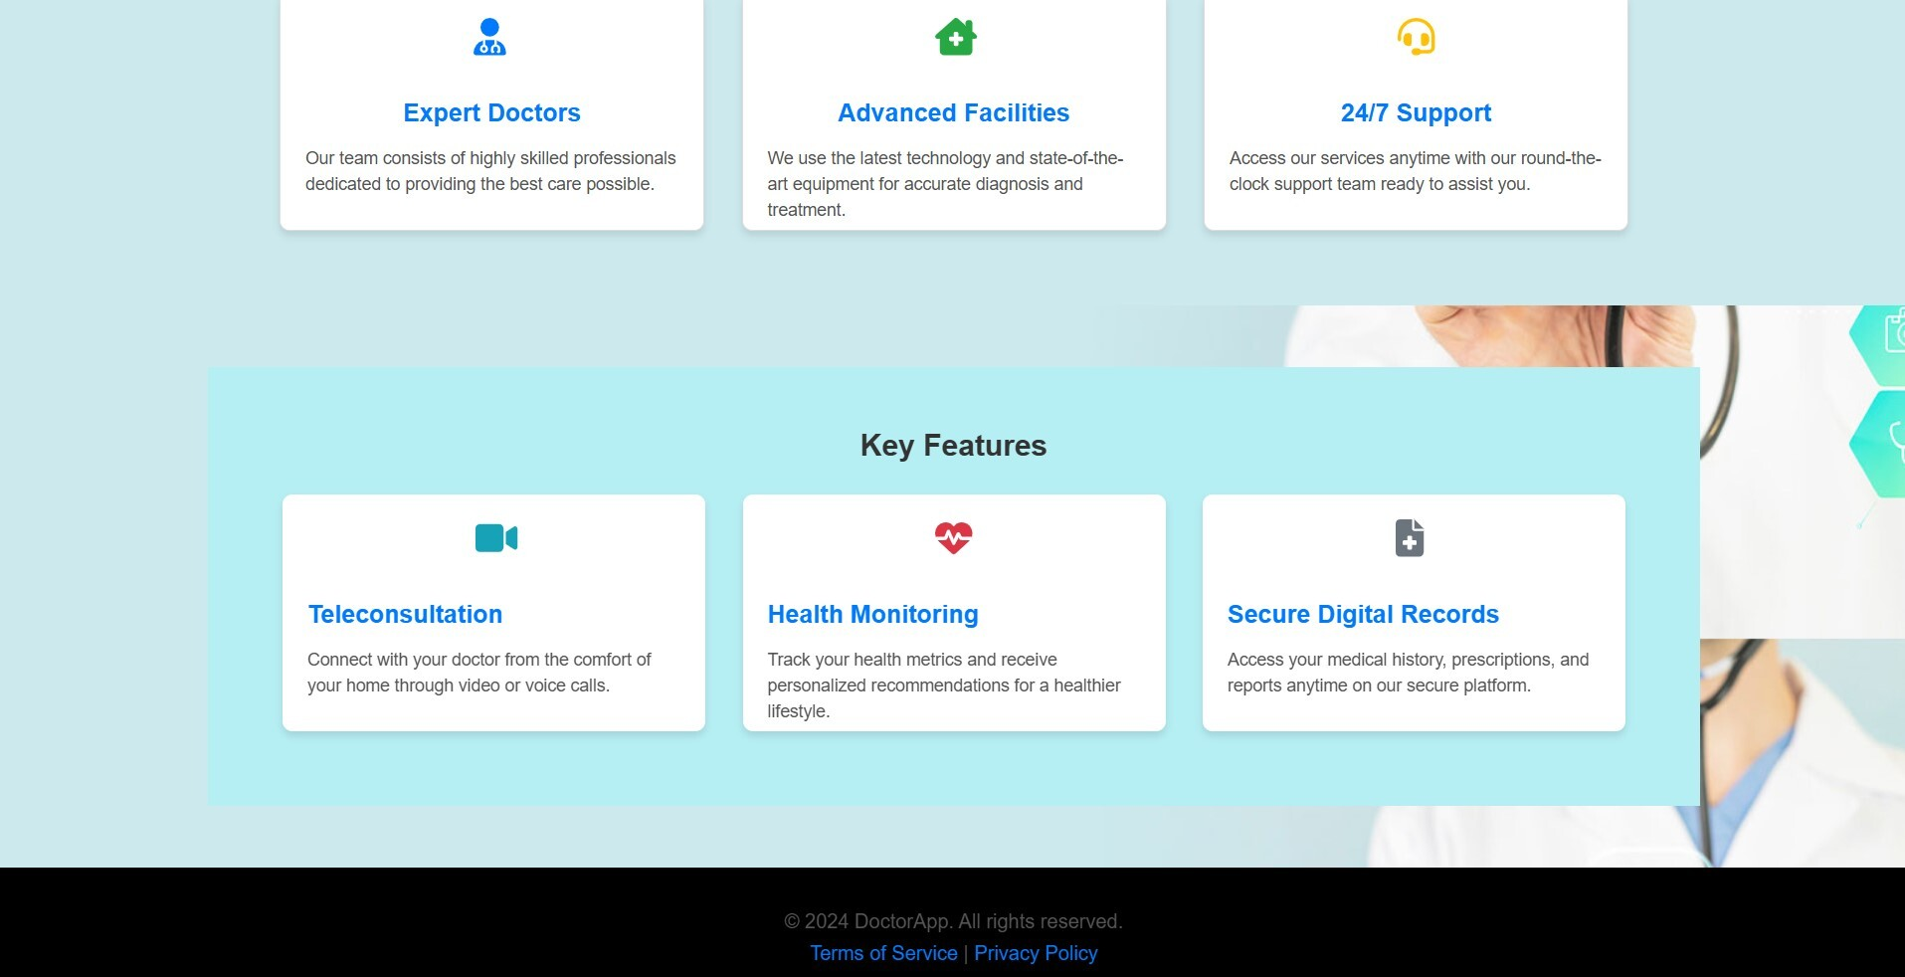
HOME PAGE

Slide 21
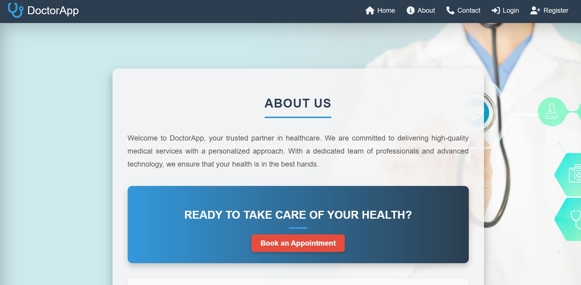
ABOUT PAGE
Click here to Know more About us

Slide 22
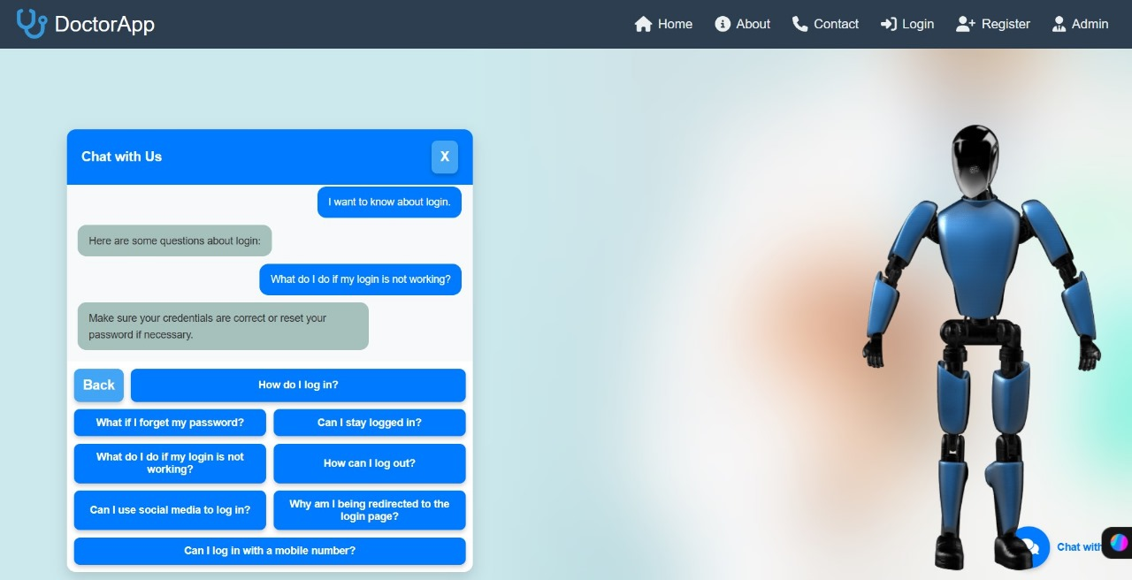
CHATBOT
Click here to Chat with us

Slide 23
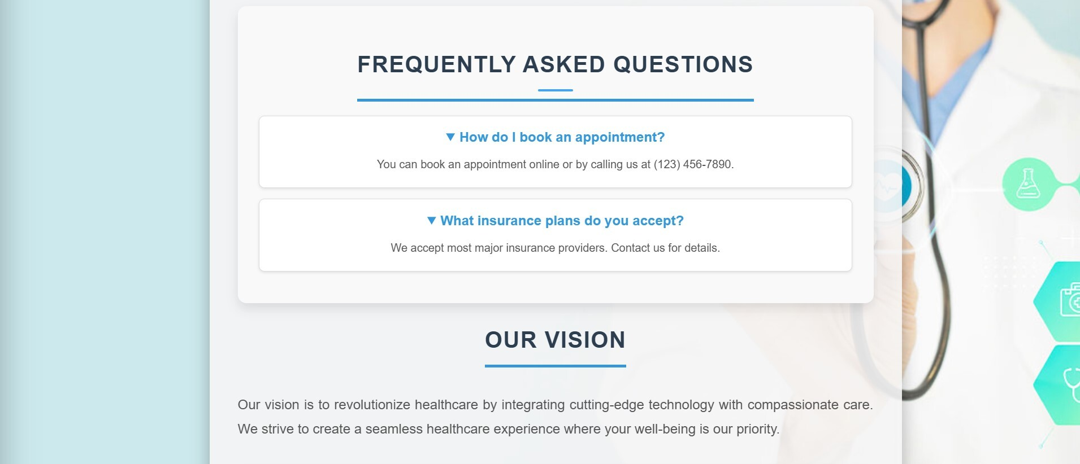
FAQs

Slide 24
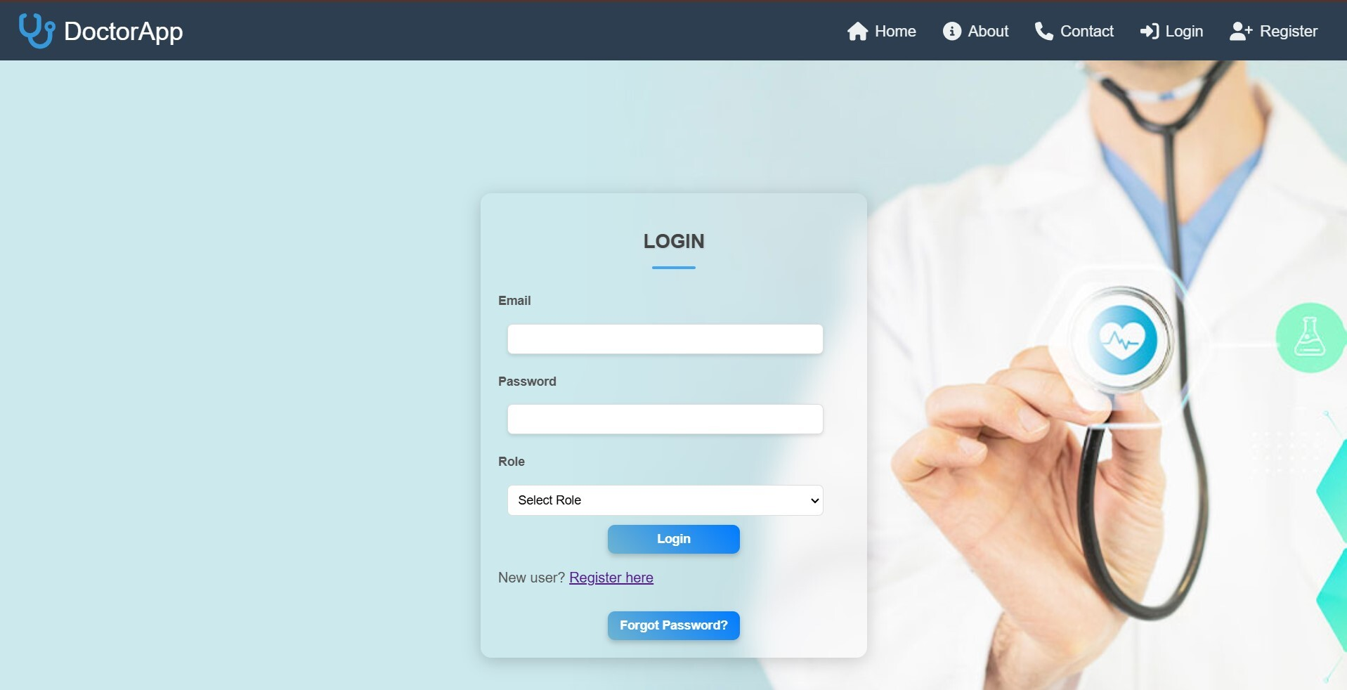
LOGIN PAGE
Click here to Login
Login with your credentials

Slide 25
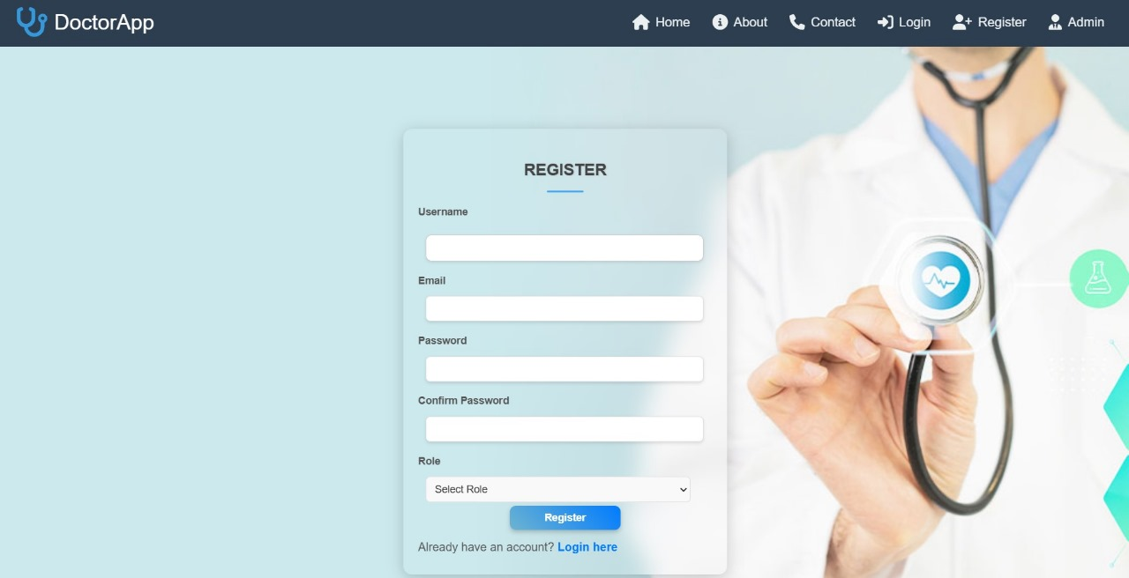
REGISTERATION PAGE
Click here to Register
Register with your Information

Slide 26
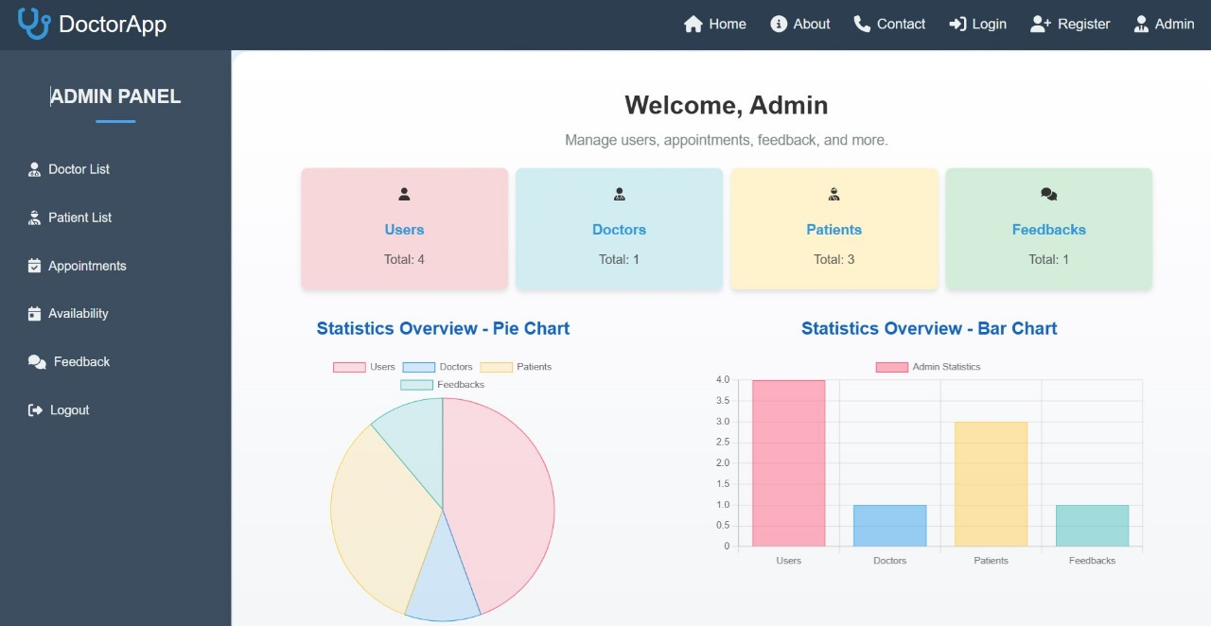
ADMIN DASHBOARD

Slide 27
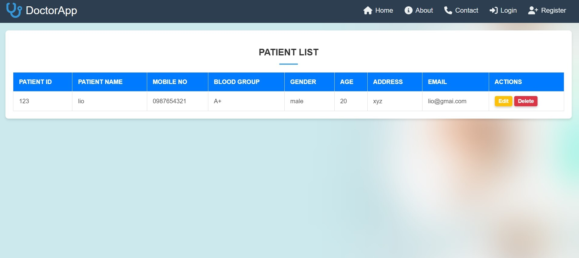
PATIENT LIST
Actions can be performed by Admin

Slide 28
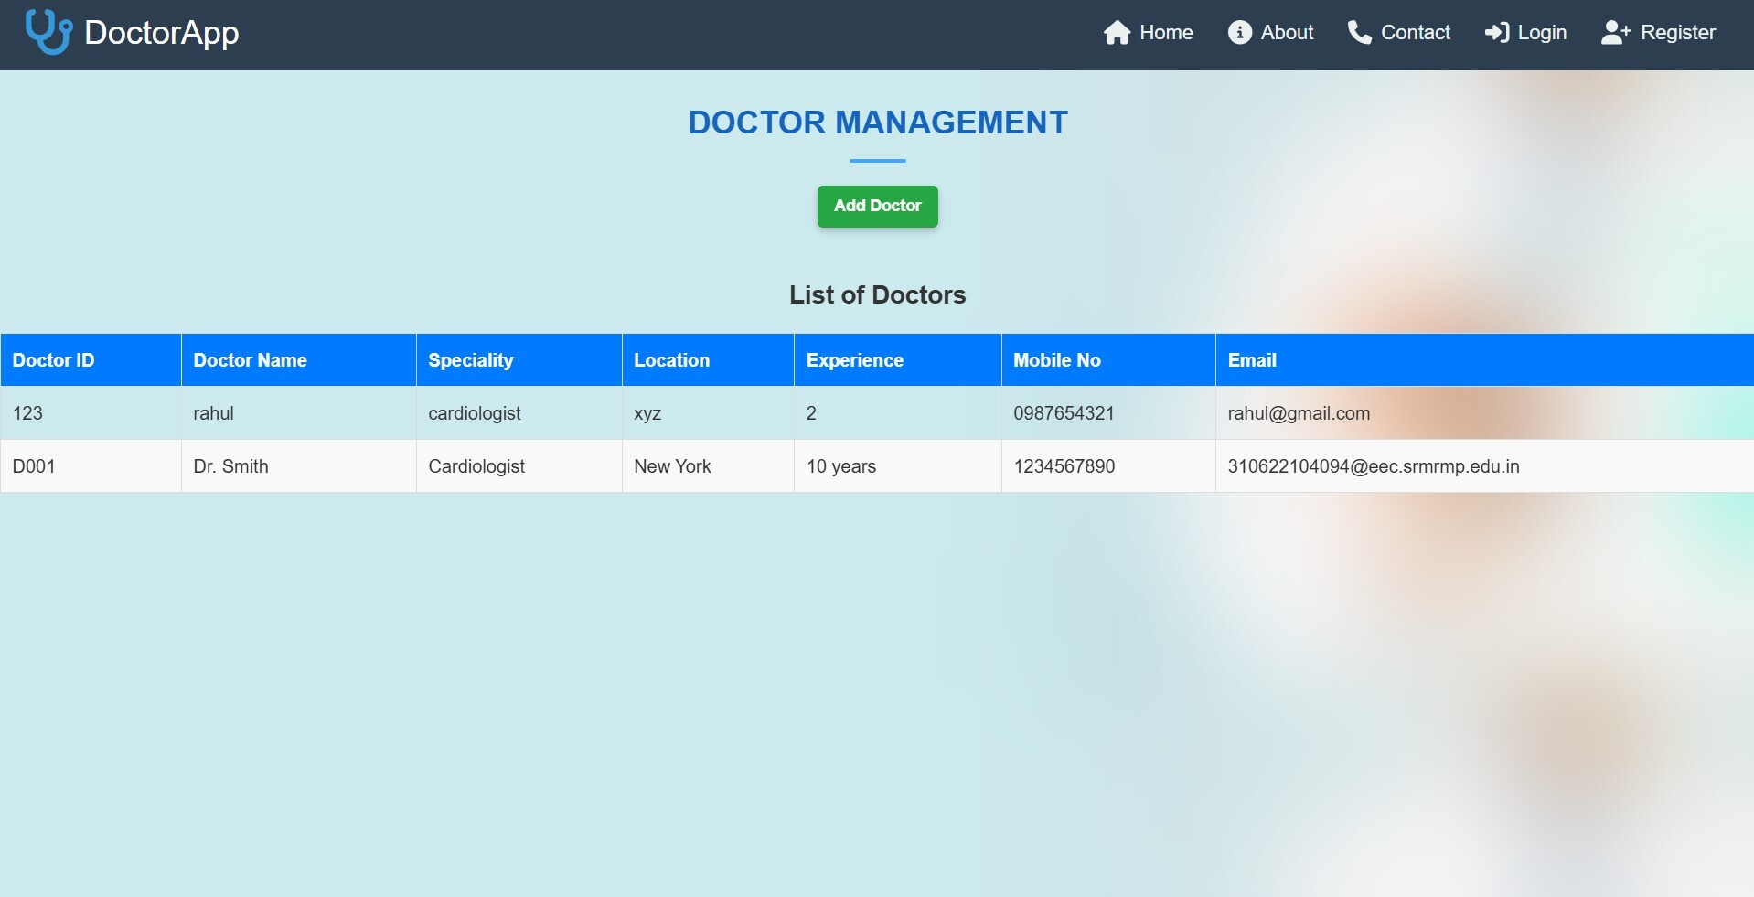
DOCTOR LIST
Doctors can be added by Admin

Slide 29
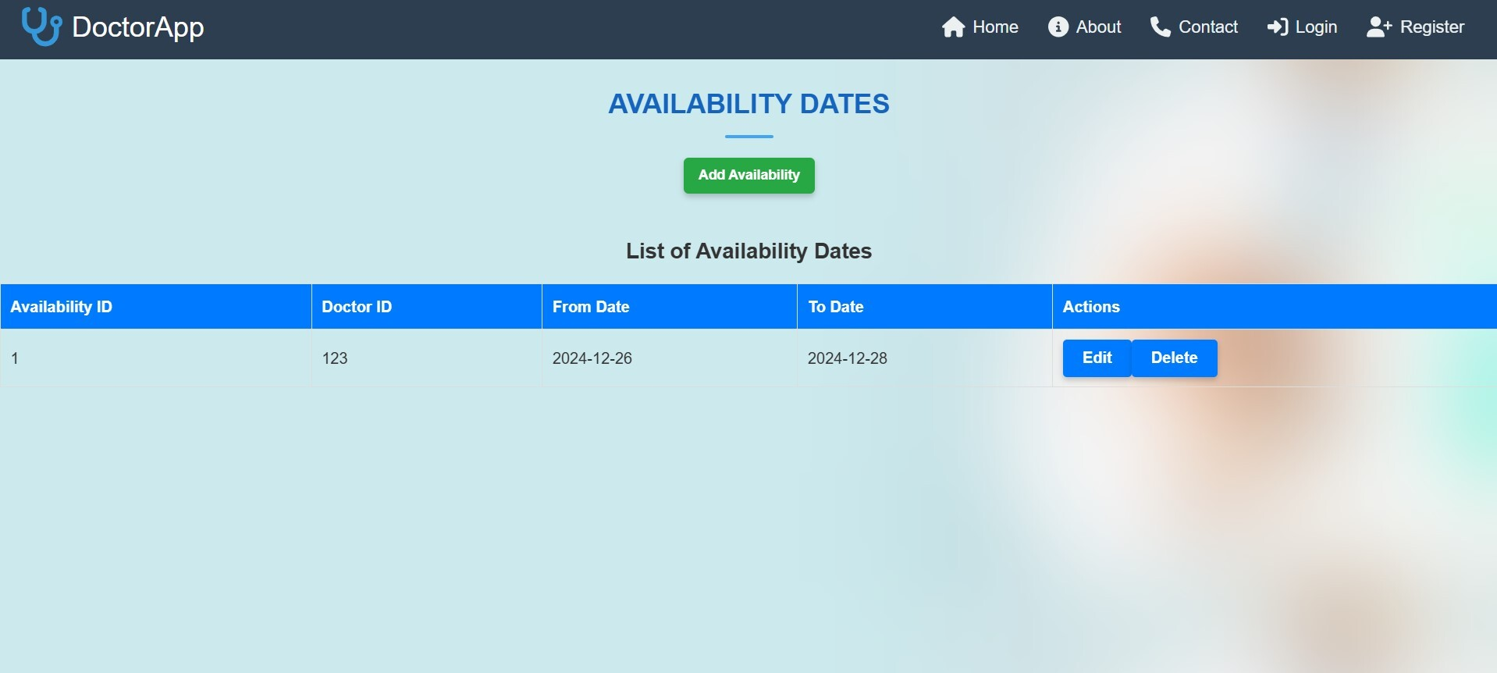
DOCTOR AVAILABILITY
Availability of Doctor can be added by Admin
Click here to perform actions by Admin

Slide 30
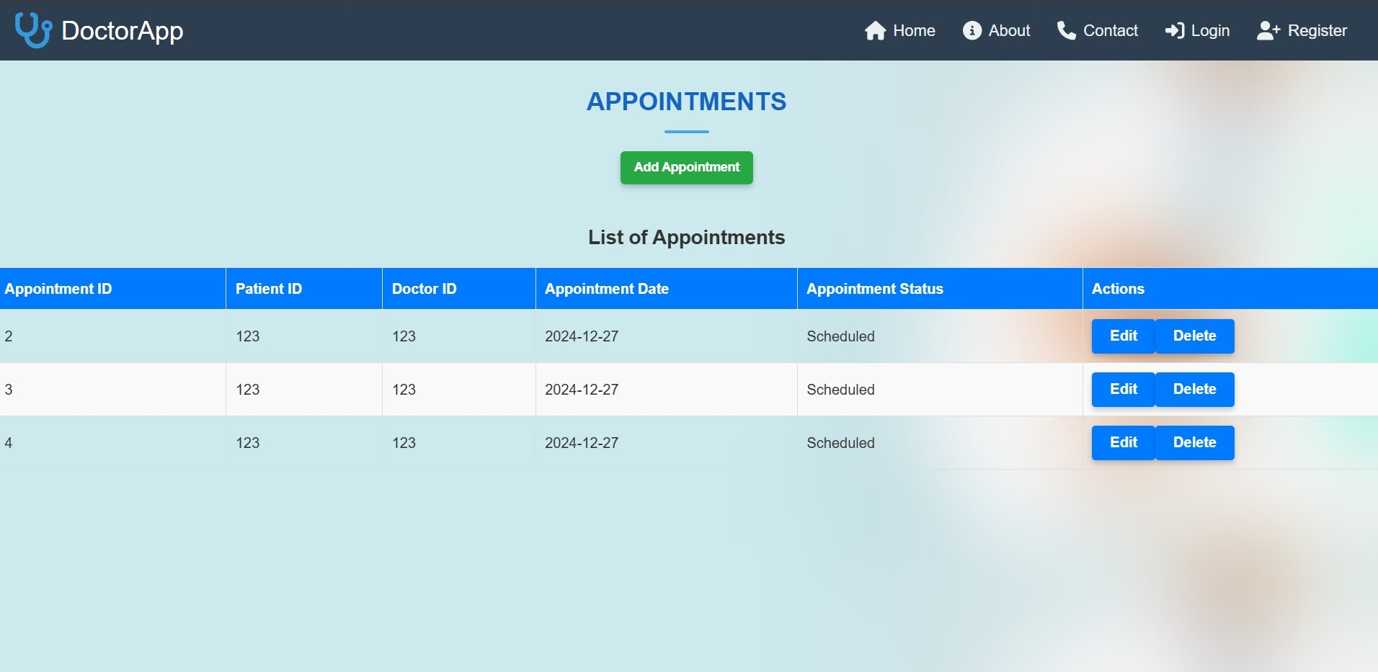
APPOINTMENTS
Appointments can be added by Admin
Click here to perform Actions by Admin

Slide 31
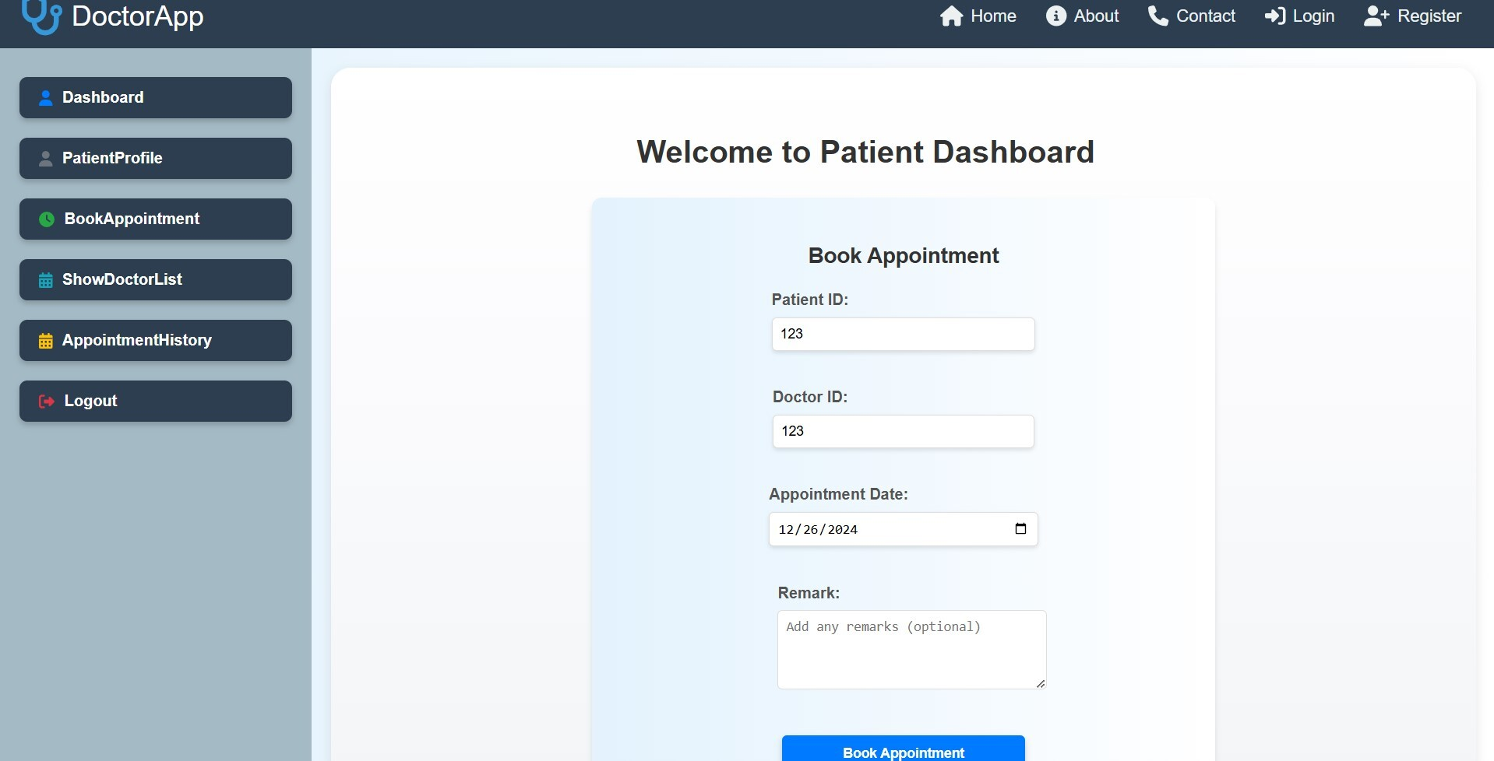
BOOK APPOINTMENT
Click here to Book Appointment
Click here to confirm appointment

Slide 32
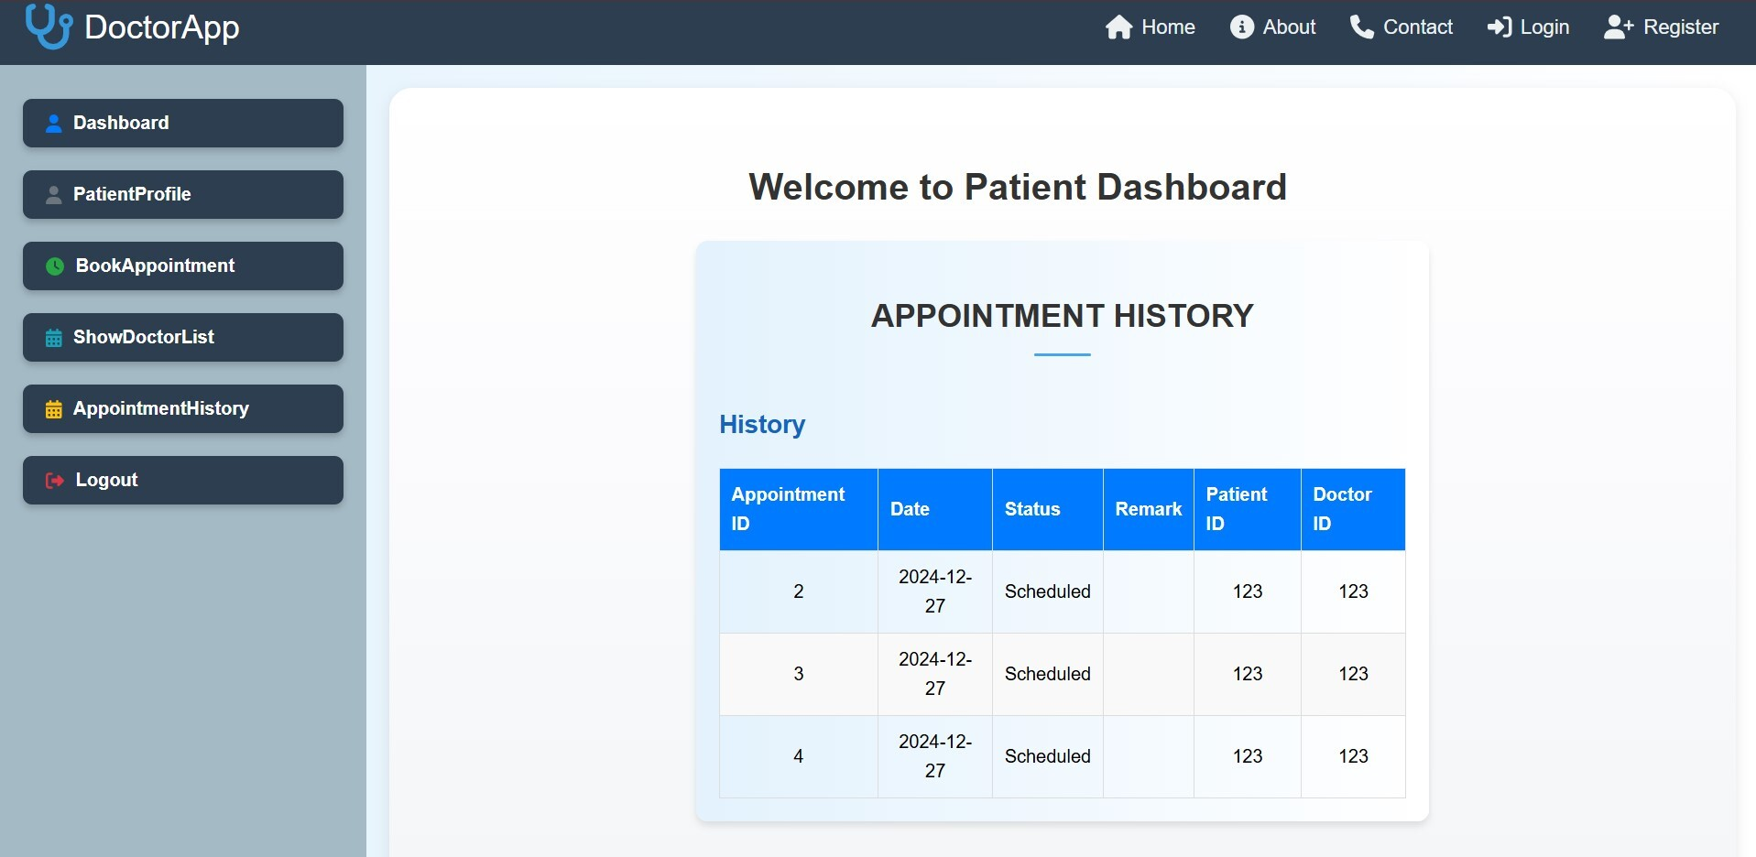
APPOINTMENT HISTORY

Slide 33
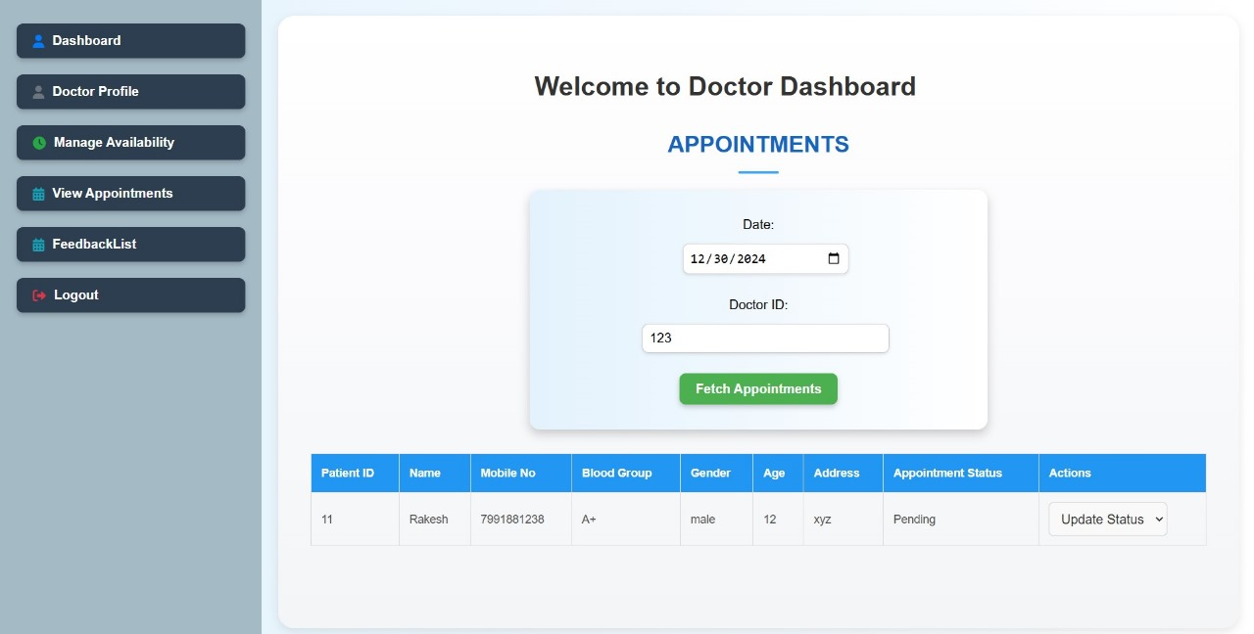
APPOINTMENTS
Click here to Fetch appointments

Slide 34
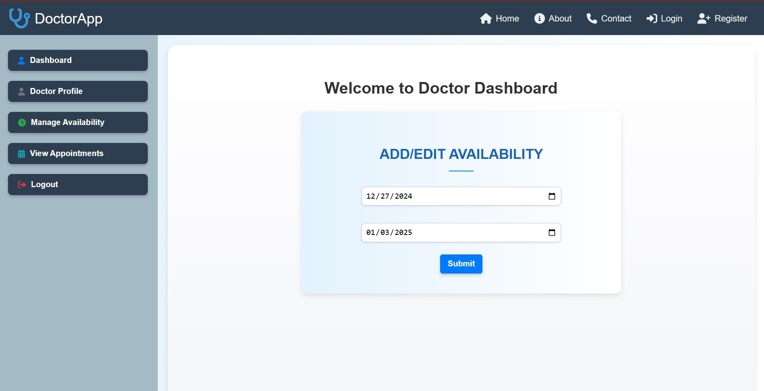
ADD AVAILABILITY
Click here to manage the availability
Click here to set your availability

Slide 35
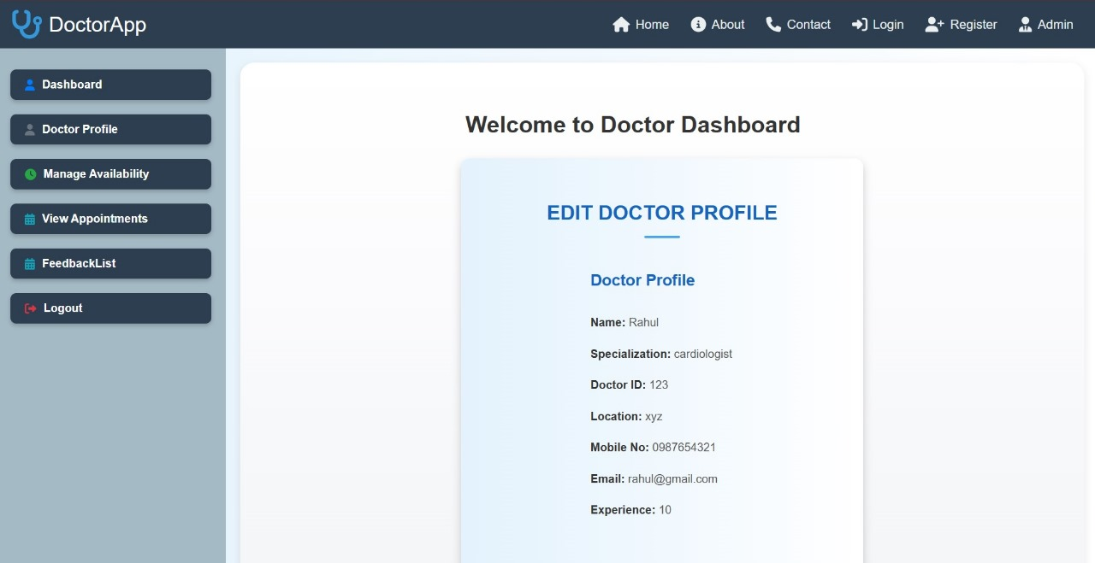
DOCTOR PROFILE
Click here to view the Doctor Profile

Slide 36
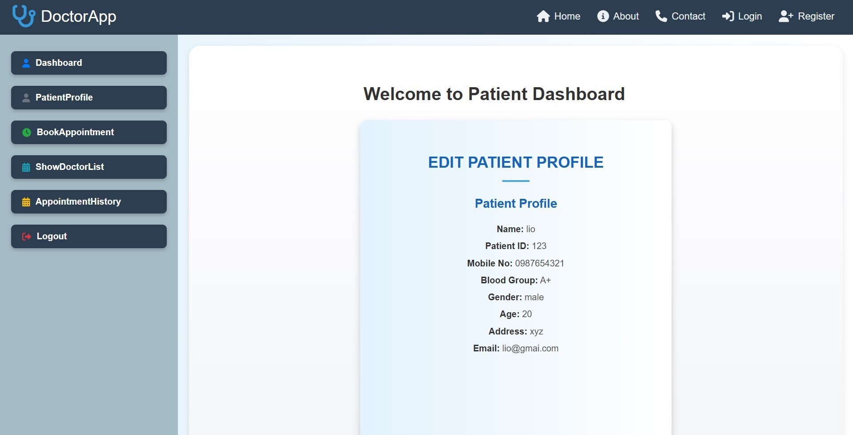
PATIENT PROFILE
Click here to view the Patient profile

Slide 37
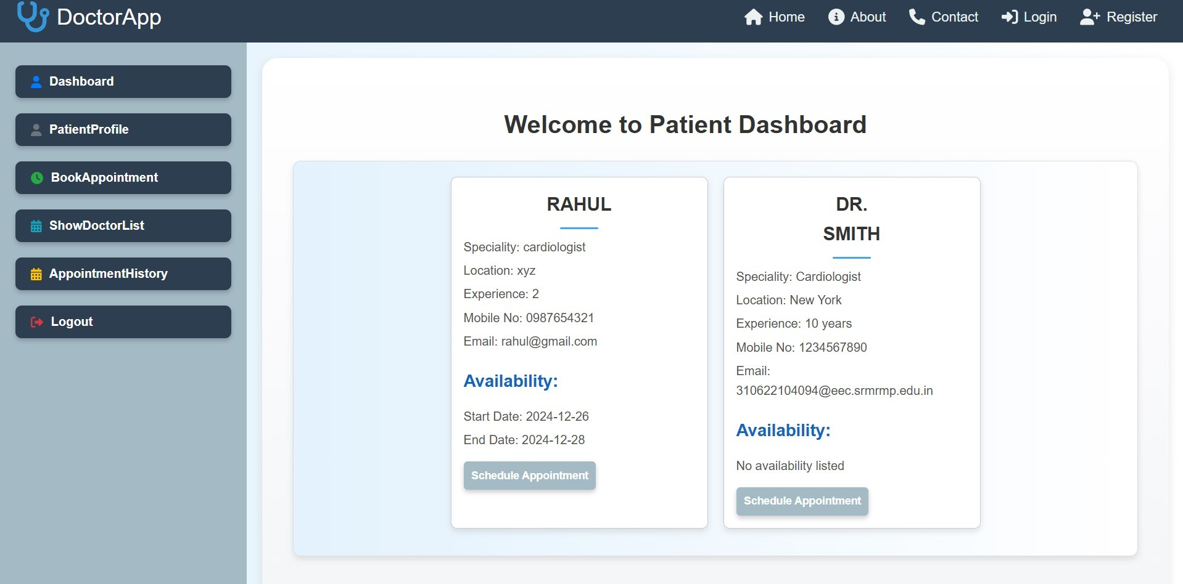
DOCTOR LIST
Click here to view the Doctor List

Slide 38
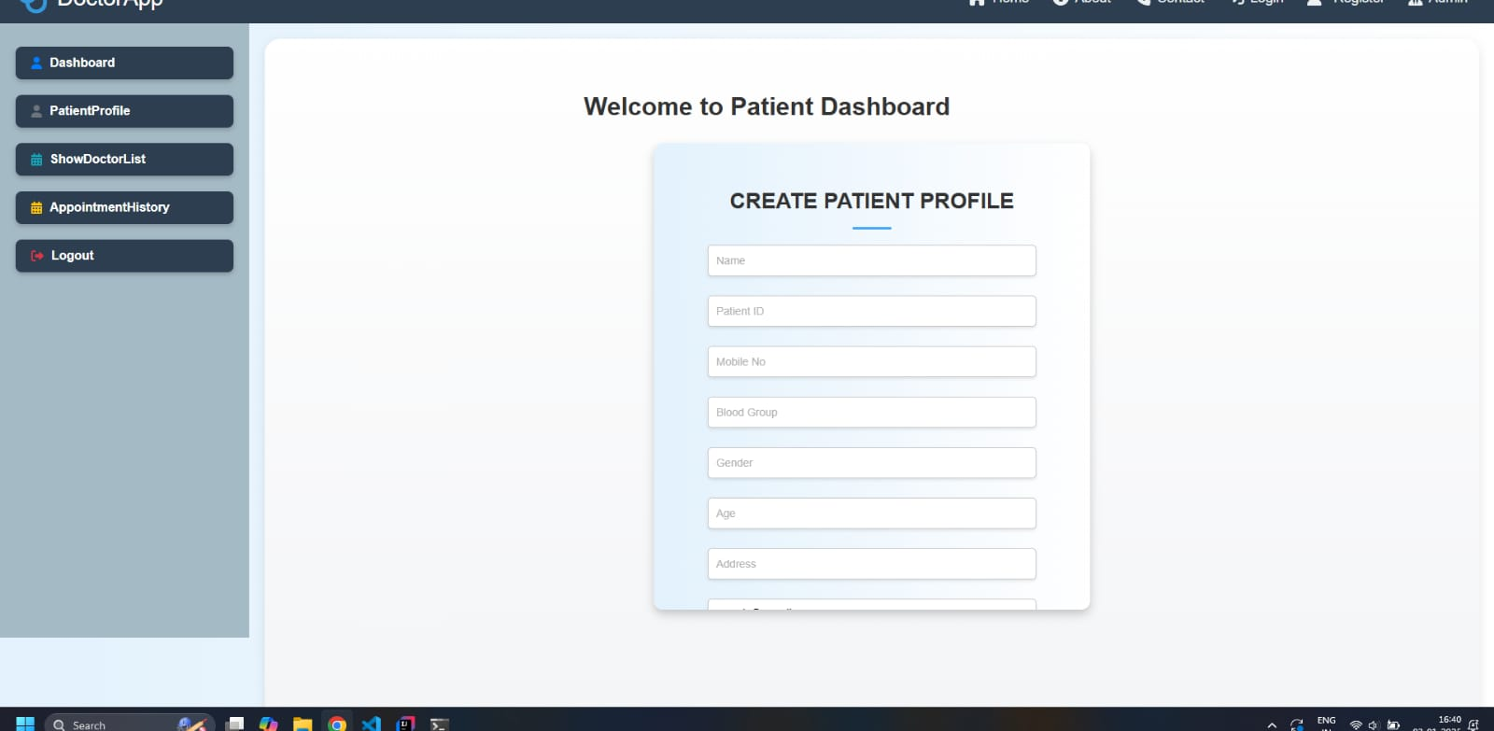
VALIDATIONS

Slide 39
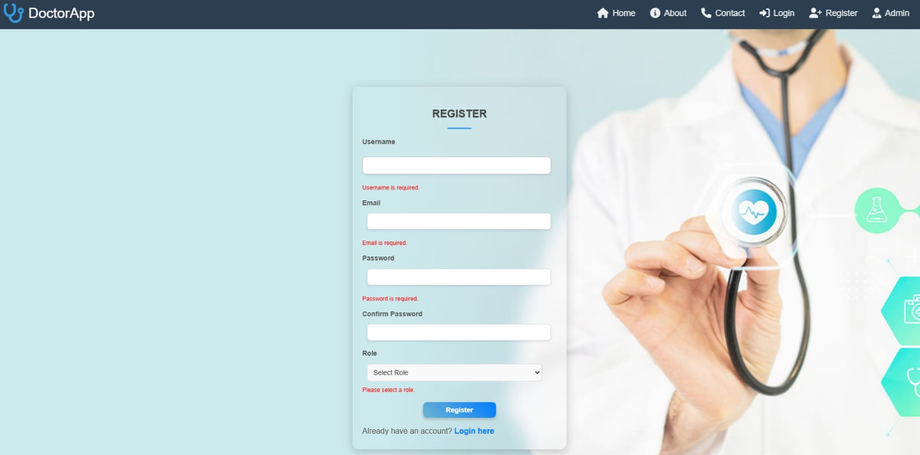
VALIDATIONS

Slide 40
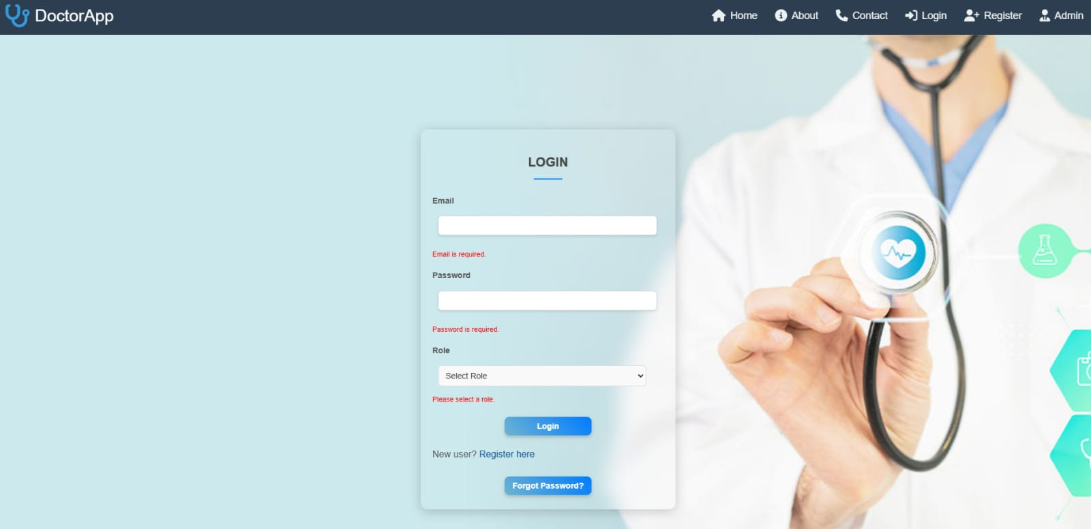
VALIDATIONS

Slide 41
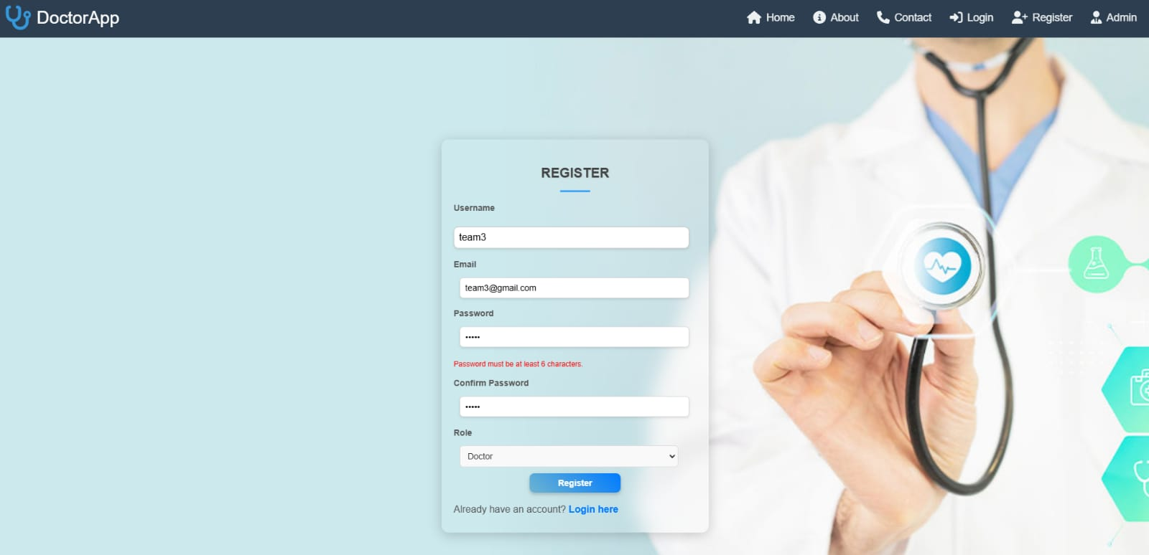
VALIDATIONS

Slide 42
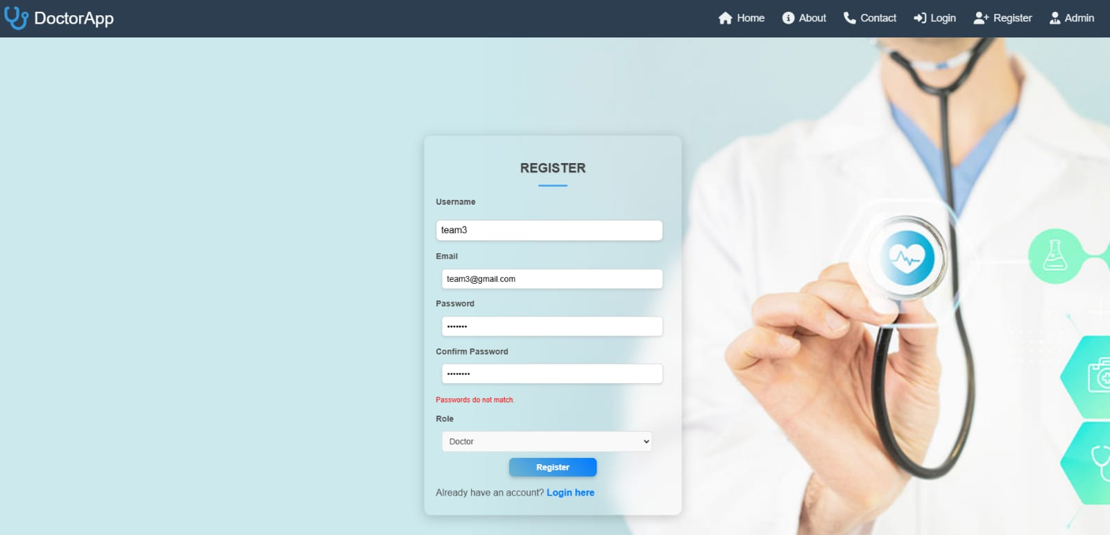
VALIDATIONS

Slide 43

THANK YOU

